Slide 1
August 29, 2013
9:00-10:00
Welcome
Updates
Handbook
Crisis Folder
TEAM News
10:00-11:00 K-2
11:00-12:00 3-5

Slide 2
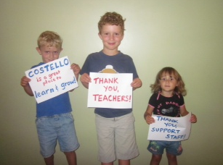

Slide 3
Opportunities
Schedule C interest forms due by end of day today
Opening for head teacher with Karen

Slide 4
Schedules
Specials rotations will begin on Wednesday
Specials schedules and lunch/recess schedules ready by Tuesday
Volunteer Slots for arrival, lunch and dismissal

Slide 5
Electronic
Attendance
and
Lunch Count

Slide 6
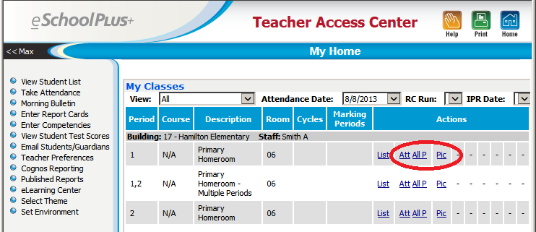
TAC – My Home
Notes:
TAC provides three ways in which attendance can be entered.
All P - Click to indicate that all students are present.
Att - Click to display the Take Attendance page for the class so you can enter attendance.
Pic - Click to display a photo attendance page for the class so you can set up your photo attendance class seating chart and enter attendance.

Slide 7
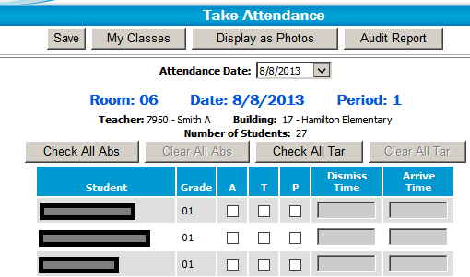
TAC – Take Attendance
Put a check-mark in the A column for students who are absent. Default Absence Code is E – Excused.
Put a check-mark in the T column for students who are tardy.
Mark a student present (P column) if you are correcting attendance that was previously entered for the student.

Slide 8
Missing Attendance Report

Slide 9
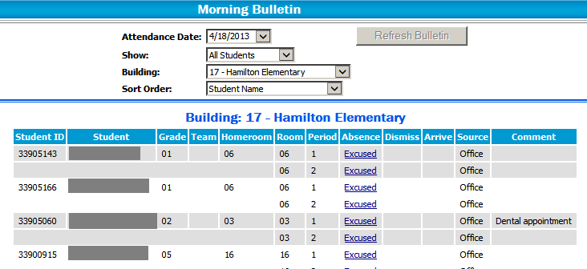
Morning Bulletin Report
Notes:
Morning Bulletin - eSchoolPlus report available to secretaries/principals listing students who were marked absent or tardy

Slide 10
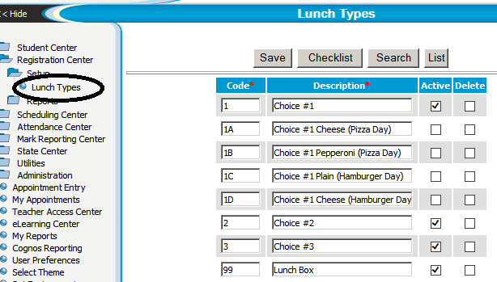
Lunch Options in eSchoolPlus
Notes:
Building secretaries have control over lunch options offered each day.

Slide 11
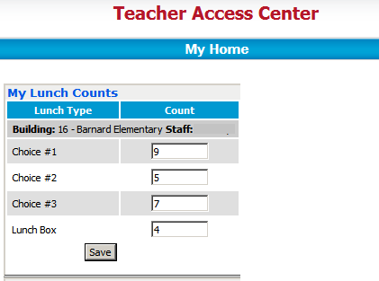
Lunch Counts in TAC
Notes:
TAC – Teacher Access Center
The My Lunch Counts section in TAC allows teachers to submit the total number of students who are buying a lunch option.
electronic lunch count that reports totals for each entrée by teacher (as opposed to being an individual student count)

Slide 12
Lunch Count Report
Notes:
Report can be run at the elementary building as well as by the cook.

Slide 13
Questions?

Slide 14
Electronic Report Cards
K-5
See communication sent to parents from Jan
Mailers to follow that will include Edline directions
Monica to facilitate sessions in computer lab on Curriculum Night September 12 to assist parents

Slide 15
alden
https://www.dropbox.com/sc/slm7yqbbc7eo4ai/lHCOrKXBSb

Slide 16
Handbook
Shared Folder titled 2013-2014
Review policies
In addition to PBIS zones review detailed safety expectations with students
Provide written details that you want noon aides to follow if different from what is printed in handbook

Slide 17
Reminders
Review safety procedures and drills – dates listed, times may or may not be shared ahead of drills
Cell phones
Dress code
Substitute folder – to be turned in by September 6

Slide 18
Turn in by September 6
Emergency forms
Accountability log – Pink sheet
Pay - to - Plug

Slide 19
Feedback…
I like it when my teacher encourages me to learn about creatures. I hope this year my teacher will let me dissect an owl pellet like my sister got to do in 3rd grade! -Brogan Withun

Slide 20
CRISIS FOLDERS
CPR certification updates
Signs posted in classroom
Classroom door windows should remain visible, when in lock down drill cover
Red and green cards to be used for all drills
Include information in sub folders
Fanny packs

Slide 21
Purchasing
District procedures
Tax exempt forms
PTO requests

Slide 22
Dismissal Improvements
End of day traffic patterns
Parent communication and training
Newsletters – encourage parents who pick children up to remain in their cars and follow the loop, less congestion in parking lot, safer and more efficient
Car rider cards
Volunteers

Slide 23
TEAM Evaluation
Reduced Elements 22 vs. 55
Timely feedback
Adjustment of domain weights
Adjustment percentages for highly effective to ineffective
Danielson Framework
Examples
Better match to district needs

Slide 24
TEAM Evaluation
No more STAGES
Danielson model interactive and easier to use
PD resources from Teachscape
60 teachers went through Teachscape training
Final percentage score eliminated
Process vs. number
Growth model

Slide 25
End of September
Personal call home to all parents
Relationship deposits
Highlighting academic or non-academic strengths

Slide 26
TEAM Evaluation
Teacher training is coming, development stages
2-day administrator training this summer

Slide 27
MDE Mandate
PBC
$2,500 additional compensation
Teacher attendance
FMLA and religious holidays

Slide 28
Requirements
No less than “effective” ratings
HE in 3 of 5 domains
Acceptable evidence
Action research projects
National Board Certification
Training integration in classroom may include data
Training is from outside district
Expectations beyond school day (academic support, school-wide leadership facilitation, etc.)

Slide 29
Committees
No more than 3 evening events per year in addition to conferences
Spread the wealth ☺

Slide 30
Making a Difference…
I liked it when my teacher complimented me on my good behavior because it felt good to hear it. It made me want to continue to do good. I hope my new teacher compliments me and my classmates sometimes on our good behavior. Looking forward to my best school year yet! Ashten Stokes

Slide 31
Impact…
Our family will never find the right words to convey how comfortable, confident and secure we are having had both of our children at Costello. To say our teacher was a natural and knew the kids very well is an understatement - a true gift.

Slide 32
What will
your
story be this year?

